Slide 1

News, October 2014

Slide 2
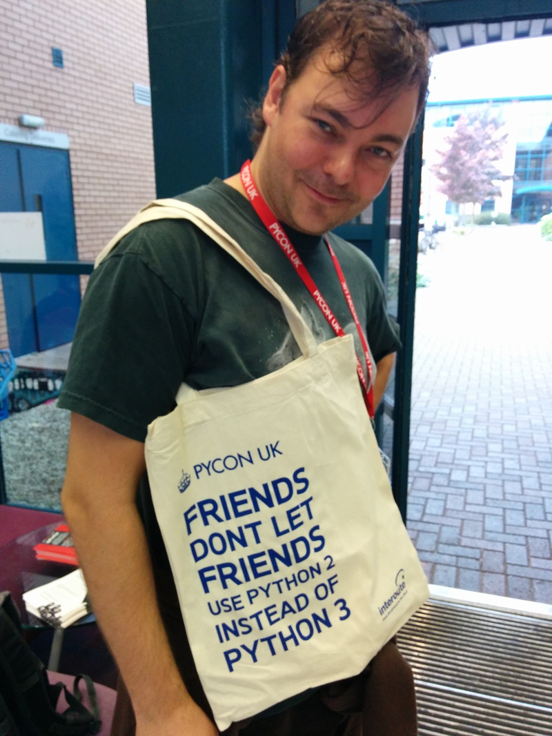
PyCon UK – the review
300+ pythonistas, ~10% pyladies.
Quantum physics, randomness, astronomy, data analysis, data provenance …
… and you missed it!?

Slide 3

Machine Learning Tutorials at Imperial!
Targeted at an MSc, PhD level at Imperial.
October 15th!
http://wp.doc.ic.ac.uk/sml/teaching/ml-tutorials/

Slide 4


This Saturday in sunny Dublin!
Two days of talks, followed by two days of sprints
Ian is the keynote!?!?

Slide 5
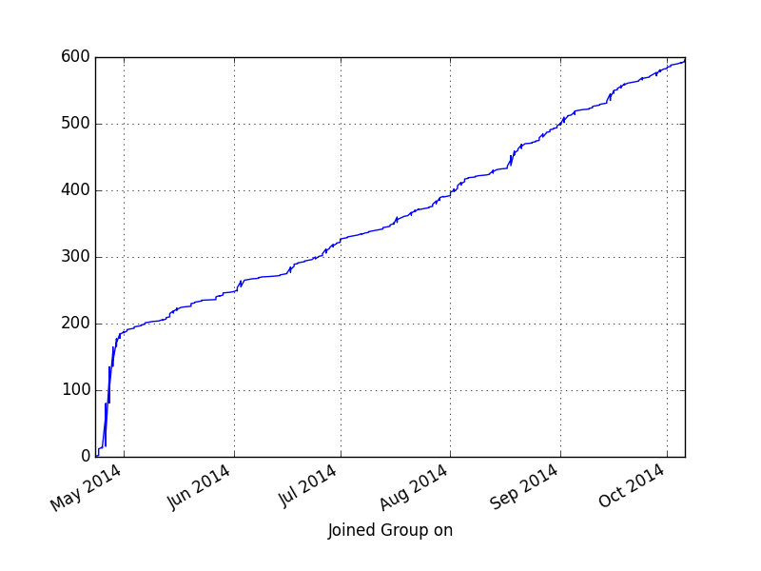
Linear growth for PyData!

Slide 6

POTM: Pyp, “The Pyed Piper”
A line-based text manipulation tool similar to AWK and SED but with Python function and syntax.
Regex, statistical functions … fully featured!
https://code.google.com/p/pyp/

